Slide 1
Lecture 7d: Control Hazards
To watch lecture video click link below
Lecture 7d video
To view slides, continue to next slide
Correction: A typo on video “Lecture 6d” should be Lecture 7d.

Slide 2
Lecture 7d: Control Hazards

Slide 3
Control Hazards
Branch determines flow of control
Fetching next instruction depends on branch outcome
When fetching the next instruction, the first (branch) instruction is still at ID stage, thus don’t know which one is the next yet
If branch taken, the target instruction will be the next
If not taken, PC+4 is the next
In MIPS pipeline
Easy solution: stall the pipeline until condition and target address ready
Problem: hurt the performance
Better solution: compare registers and compute target address early
Add hardware to do it in ID stage
Thus, during the ID stage, we know branch is taken or not
And, if taken, what is the target address.

Slide 4
Example
36: sub $10, $4, $8 #here 36 is the IM address 40: beq $1, $3, 7 #if equal, jump 7 * 4 bytes to 72 44: and $12, $2, $5 48: or $13, $2, $6 52: add $14, $4, $2 56: slt $15, $6, $7 ... 72: lw $4, 50($7) #72 is the target address
We will illustrate the pipeline time diagrams in cases of branch taken and not taken for the scenarios of “easy solution –condition and target address calculation in EX/ALU stage” as well as the “better solution – condition and target address calculation in ID/Regs stage”.

Slide 5
Easy Solution: branch not taken
In this case, pipeline as usual.
 | CC1 | CC2 | CC3 | CC4 | CC5 | CC6 | CC7 | CC8 | CC9
sub | IM | Regs | ALU | DM | Regs
beq |  | IM | Regs | ALU | DM | Regs
and |  |  | IM | Regs | ALU | DM | Regs
or |  |  |  | IM | Regs | ALU | DM | Regs
add |  |  |  |  | IM | Regs | ALU | DM | Regs
…
Assume beq completes the calculation of the condition and target address by DM cycle (i.e. CC5), by then, the following 3 instructions already fetched, and we know condition false so no jump. Thus the already fetched instructions are the correct ones to be executed. Pipeline as normal.

Slide 6
Easy Solution: branch taken
In this case, has to flush out 2 instructions
 | CC1 | CC2 | CC3 | CC4 | CC5 | CC6 | CC7 | CC8 | CC9
sub | IM | Regs | ALU | DM | Regs
beq |  | IM | Regs | ALU | DM | Regs
and |  |  | O | O | O | O | O
or |  |  |  | O | O | O | O | O
lw |  |  |  |  | IM | Regs | ALU | DM | Regs
By CC4, we know condition (equal, so branch taken) and target address (the lw instruction is the correct one to fetch as next instruction.)
By CC4, need to flush two already fetched instructions, and, or out of pipeline.
Detailed pipeline flushing not discussed here. We simply use “O” as bubbles indicating these two cycles are stall cycles.

Slide 7
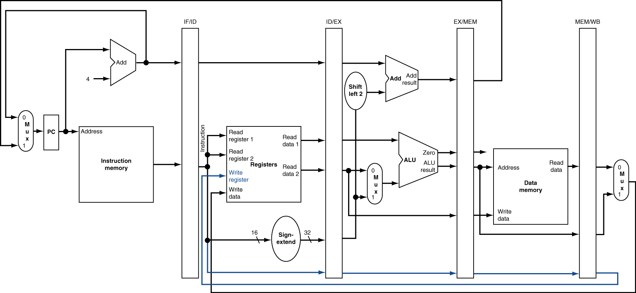

Slide 8
Better Solution: branch taken
Better solution: use special hardware to compute condition and target address at 2nd (ID/Regs) stage.
In this case, only need to flush out 1 instruction.
 | CC1 | CC2 | CC3 | CC4 | CC5 | CC6 | CC7 | CC8 | CC9
sub | IM | Regs | ALU | DM | Regs
beq |  | IM | Regs | ALU | DM | Regs
and |  |  | O | O | O | O | O
lw |  |  |  | IM | Regs | ALU | DM | Regs
With hardware improvement, only 1 stall needed for branch taken.
The stall cycle(s) caused by branch taken is commonly referred to as “Branch Penalty”. With easy solution, branch penalty is 2 cycles. With improved/better solution, the branch penalty is 1 cycle.

Slide 9
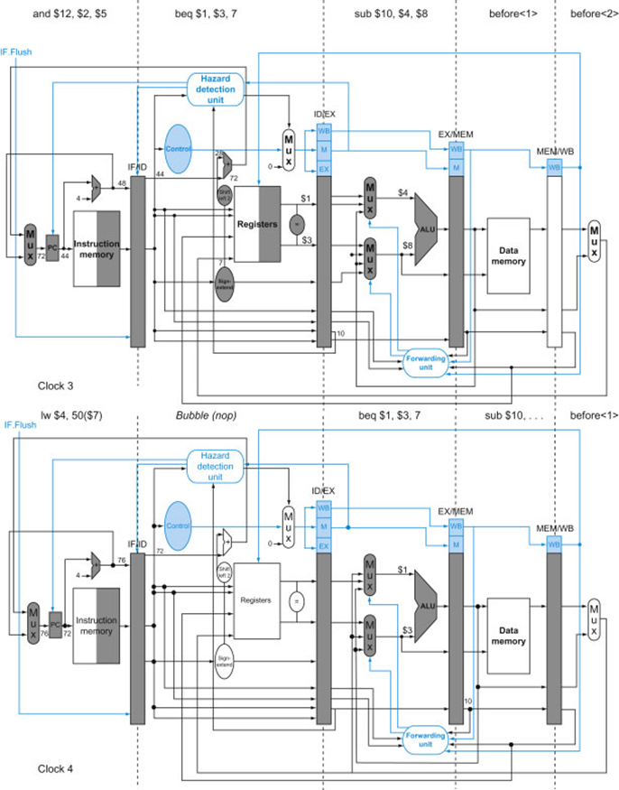

Slide 10
Better Solution: branch not taken
Same as easy solution, in this case Pipeline as normal,
 | CC1 | CC2 | CC3 | CC4 | CC5 | CC6 | CC7 | CC8 | CC9
sub | IM | Regs | ALU | DM | Regs
beq |  | IM | Regs | ALU | DM | Regs
and |  |  | IM | Regs | ALU | DM | Regs
or |  |  |  | IM | Regs | ALU | DM | Regs
add |  |  |  |  | IM | Regs | ALU | DM | Regs
…

Slide 11
Reducing Branch Penalty: Summary
Move hardware to determine outcome to ID/Regs stage
Target address adder
Register comparator
Detailed hardware diagram omitted
Just remember: for beq condition and target addresses are calculated in 2nd stage.
Improvement
Branch penalty (in case of branch taken) is 1 cycle.
Complexity
Control hazard mixing with branch hazard

Slide 12
Branch Prediction
Theoretically there are a few Branch Prediction methods
MIPS 5-stage pipeline is very simple, only one prediction scheme possible!
In MIPS, we are predicting “branch not taken”
If predicted right (not taken)
pipeline as normal, no stall (i.e. no penalty).
If predicted wrong (taken)
(at least) One stall needed
One stall: with special hardware support, and no data hazard for beq.
need to flushing instructions, i.e. through away the following instructions (that are fetched wrong) at the pipeline.
That’s exactly what we illustrated previously

Slide 13
Data Hazards for Branches
If a comparison register is a destination of immediately preceding load instruction (i.e. R1 in the following example)
R1 value read out at MEM/DM stage of lw
R1 value needed at ID/Regs stage for beq
Need 2 stall cycles
lw $1, …
IF
ID
EX
MEM
WB
beq stalled
IF
ID
beq stalled
ID
beq $1, $0, target
ID
EX
MEM
WB

Slide 14
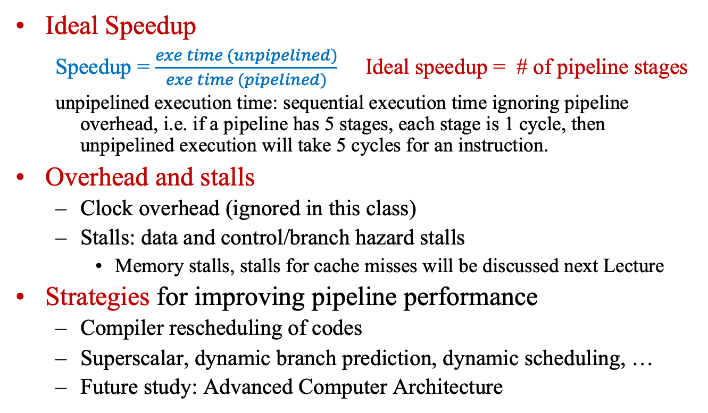
Pipeline Performance
Ideal Speedup
Speedup = $\frac{exe time (unpipelined)}{exe time (pipelined)} I$deal speedup = # of pipeline stages
unpipelined execution time: sequential execution time ignoring pipeline overhead, i.e. if a pipeline has 5 stages, each stage is 1 cycle, then unpipelined execution will take 5 cycles for an instruction.
Overhead and stalls
Clock overhead (ignored in this class)
Stalls: data and control/branch hazard stalls
Memory stalls, stalls for cache misses will be discussed next Lecture
Strategies for improving pipeline performance
Compiler rescheduling of codes
Superscalar, dynamic branch prediction, dynamic scheduling, …
Future study: Advanced Computer Architecture

Slide 15
Pipeline Performance -- Example
In a 5-stage pipeline with forwarding mechanism as discussed in the lecture, assume the delay by data and control hazards are as follows: 1 cycle stall for the load by immediate use, 1 cycle stall for branch taken as well as unconditional jumps. (note: here we consider j instruction as a beq with conditional always true.)
Of all the instructions:
(1) 30% are lw instructions. 10% of lw instructions are followed by instructions that use lw result immediately;
(2)10% are branch instructions with 40% possibility of branch taken;
(3) 5% of are unconditional jumps.
What will be the effective CPI with the existence of above data and control hazards?
(Note: ignoring all other pipeline overhead. Hint: ideal pipeline CPI = 1.)

Slide 16
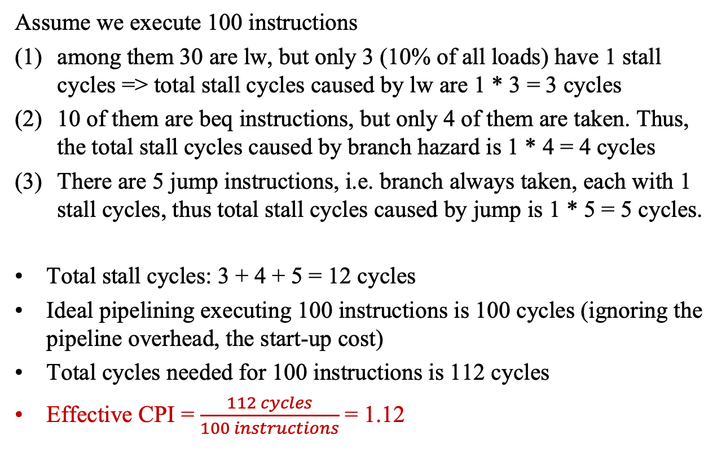
Pipeline Performance -- Solution
Assume we execute 100 instructions
among them 30 are lw, but only 3 (10% of all loads) have 1 stall cycles => total stall cycles caused by lw are 1 * 3 = 3 cycles
10 of them are beq instructions, but only 4 of them are taken. Thus, the total stall cycles caused by branch hazard is 1 * 4 = 4 cycles
There are 5 jump instructions, i.e. branch always taken, each with 1 stall cycles, thus total stall cycles caused by jump is 1 * 5 = 5 cycles.
Total stall cycles: 3 + 4 + 5 = 12 cycles
Ideal pipelining executing 100 instructions is 100 cycles (ignoring the pipeline overhead, the start-up cost)
Total cycles needed for 100 instructions is 112 cycles
Effective CPI = $\frac{112 cycles}{100 instructions}$ = 1.12

Slide 17
Pipeline Performance -- Solution
Simply we could calculate the effective CPI as follows:
Effective CPI = 1 + 30%*10% * 1 + 10% * 40% * 1 + 5% * 1 = 1.12
Analysis: The above example shows that data and control hazards may increase the pipeline execution time by ab out 12%. Yes, data and control hazards do affect performance, but not a lot.

Slide 18
Pipeline Summary
Pipelining improves performance by increasing instruction throughput
Executes multiple instructions in parallel
Each instruction has the same latency
Subject to hazards
Structure, data, control
Instruction set design affects complexity of pipeline implementation
MIPS simple 5-stage pipeline

